Slide 1







Serverless Computing – A Security Perspective
PRESENTED BY :
BHOOMI NAIK - 52
JANHAVI MANDHAN - 50
DHIRAJ ROHRA - 61
DIPESH MAKDIYA - 49
CLASS : D10C
SUBJECT : OS CA-2
INSTITUTION: VIVEKANAND EDUCATION SOCIETY'S INSTITUTE OF TECHNOLOGY

Slide 2

INTRODUCTION
Definition: Serverless computing allows developers to focus on code execution without managing infrastructure.
Models:
Backend as a Service (BaaS) - Managed services for applications.
Function as a Service (FaaS) - Developers write and execute code as
individual functions.
Benefits: Pay-per-use model, scalability, and no server management.

Slide 3
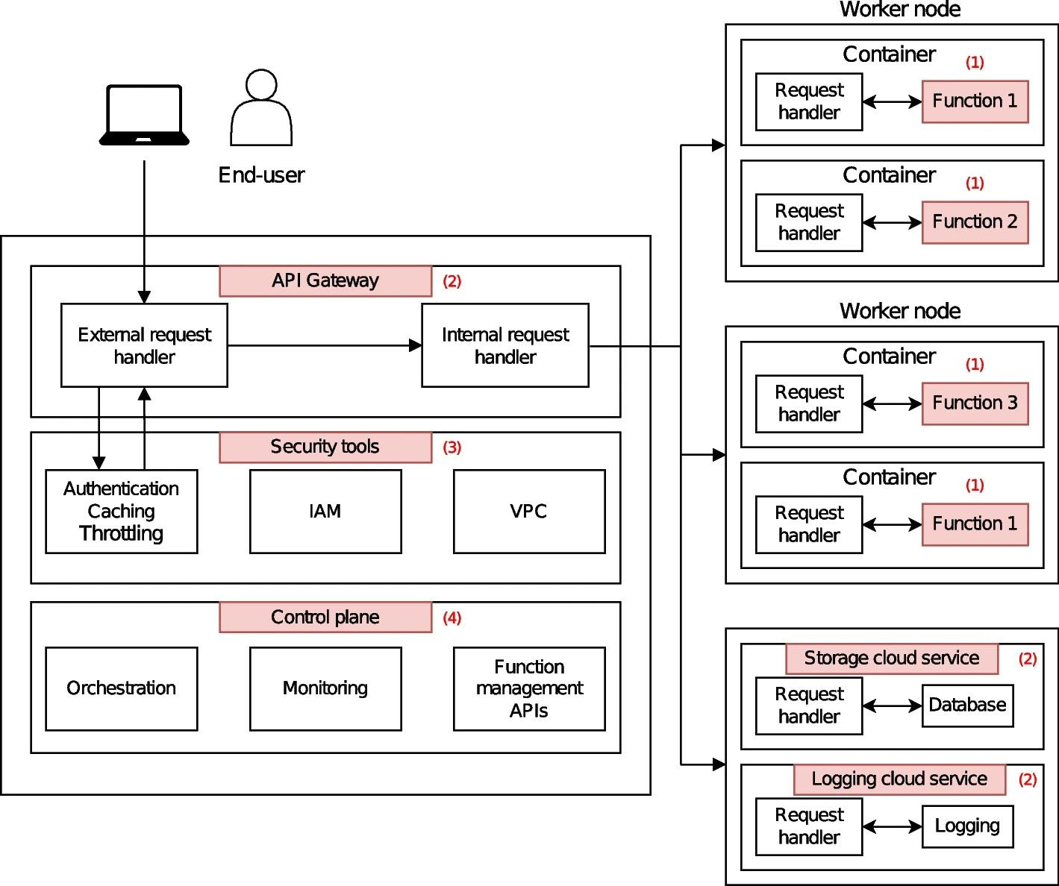
SERVERLESS
ECOSYSTEM
Components:
Functions (stateless & event-driven)
API Gateways
Cloud Services (Databases, Storage, Messaging)
Security Tools (IAM, VPC)
Control Plane (orchestration, monitoring)

Slide 4
SECURITY ADVANTAGES OF SERVERLESS
Short-lived functions reduce attack time
Fine-grained permissions limit access
Auto-scaling helps mitigate DoS attacks
Shared security responsibility (Cloud provider & Developer)

Slide 5
SECURITY RISKS AND CHALLENGES
Increased Attack Surface: More API endpoints and event triggers.
Shared Infrastructure Risks: Possible side-channel attacks.
Lack of Visibility: Cloud providers’ security mechanisms are not always transparent.
Denial of Wallet (DoW) Attacks: Attackers can increase resource consumption to drive up costs.

Slide 6

THREAT MODEL
External Threats:
Injection attacks (SQL, XSS, Command injection)
API Exploitation
Event Injection
Internal Threats:
Malicious insider functions
Privilege Escalation
Side-Channel Attacks

Slide 7
APPLICATION-LEVEL ATTACKS
Common Vulnerabilities:
Injection attacks (SQL, NoSQL, OS commands)
Broken Authentication
Deserialization Attacks
Third-party Library Risks
Countermeasures:
Input validation & sanitization
Strong IAM policies
Regular dependency updates

Slide 8
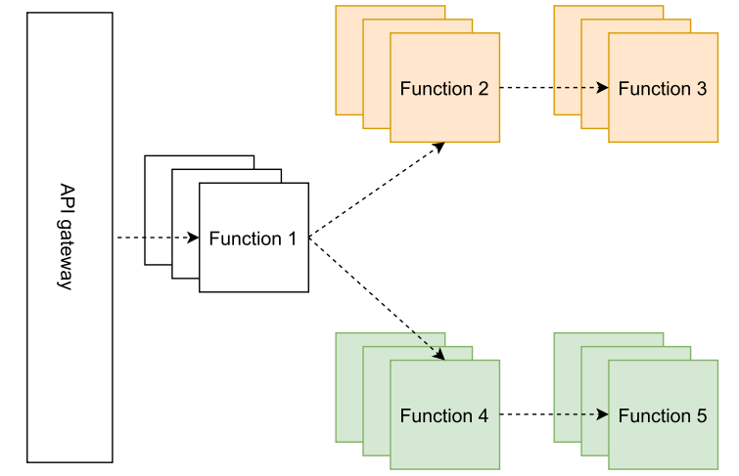
INFRASTRUCTURE-LEVEL ATTACKS
Side-Channel Attacks: Exploiting shared resources.
Race Conditions: Inconsistent function versions.
Long-Lasting Attacks: Using /tmp/ storage to persist malware.
Denial-of-Wallet (DoW) Attacks: Resource abuse increasing billing costs.

Slide 9
COUNTERMEASURES
Best Practices for Security:
Implement least privilege access (RBAC, ABAC).
Use monitoring tools for anomaly detection.
Secure function-to-function communication.
Set up billing alerts to prevent DoW attacks.

Slide 10
CONCLUSION
Serverless computing simplifies deployment but introduces unique security challenges.
Developers and cloud providers must share responsibility for security.
Future research should focus on improving isolation and monitoring in serverless environments.

Slide 11
Thank You
References :
Serverless computing: a security perspective
OWASP Serverless Security Guide

